Slide 1



bit.ly/ionkerul
Ionic T01 Intro

Slide 2
bit.ly/ionkerul
Ionic5

Slide 3


Slide 4
OVERVIEW
TO IONIC FRAMEWORK

Slide 5

What is Ionic?
Ionic Framework is an open source UI toolkit for building performant, high-quality mobile and desktop apps using web technologies (HTML, CSS, and JavaScript).

Slide 6
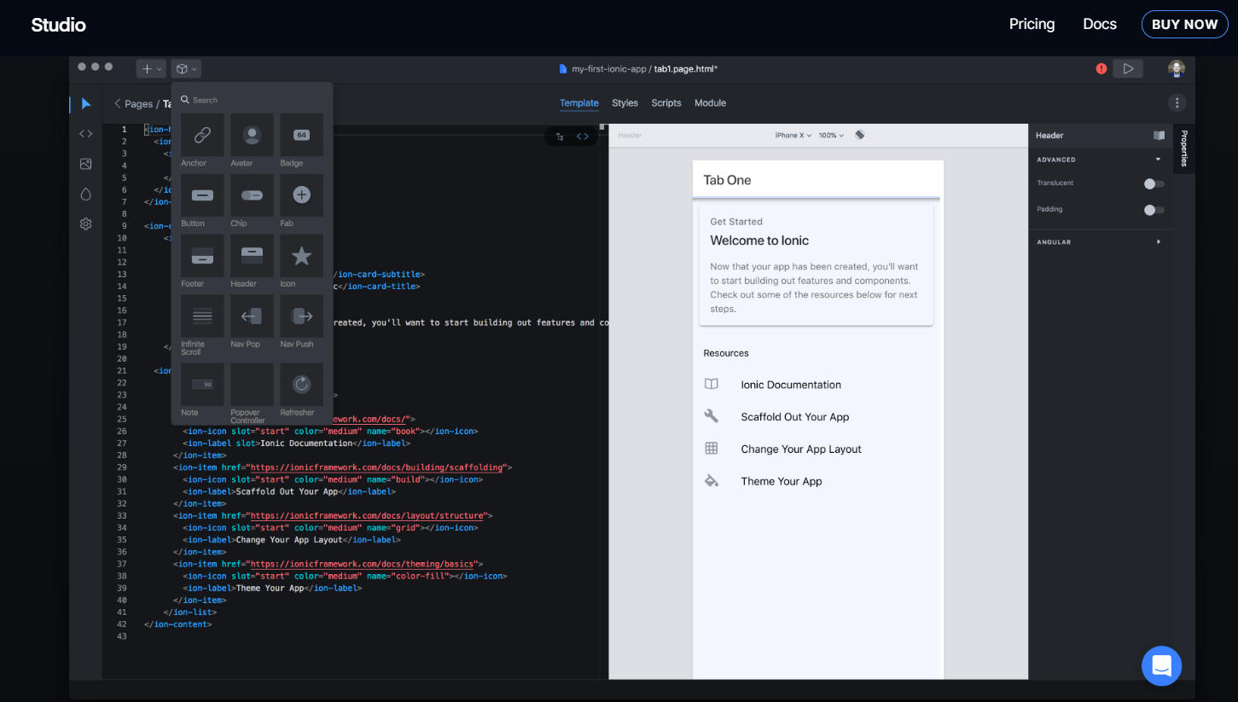
Ionic Studio

Slide 7
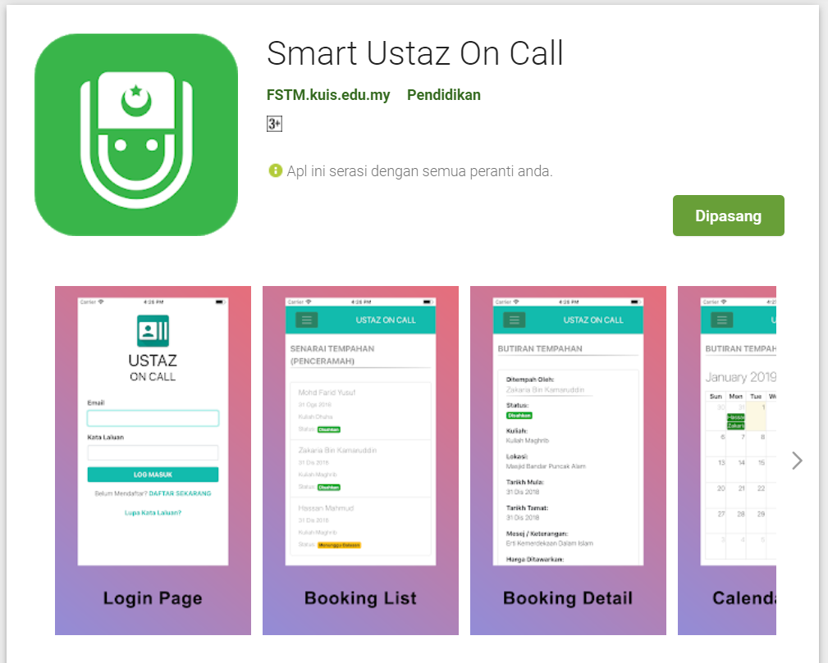
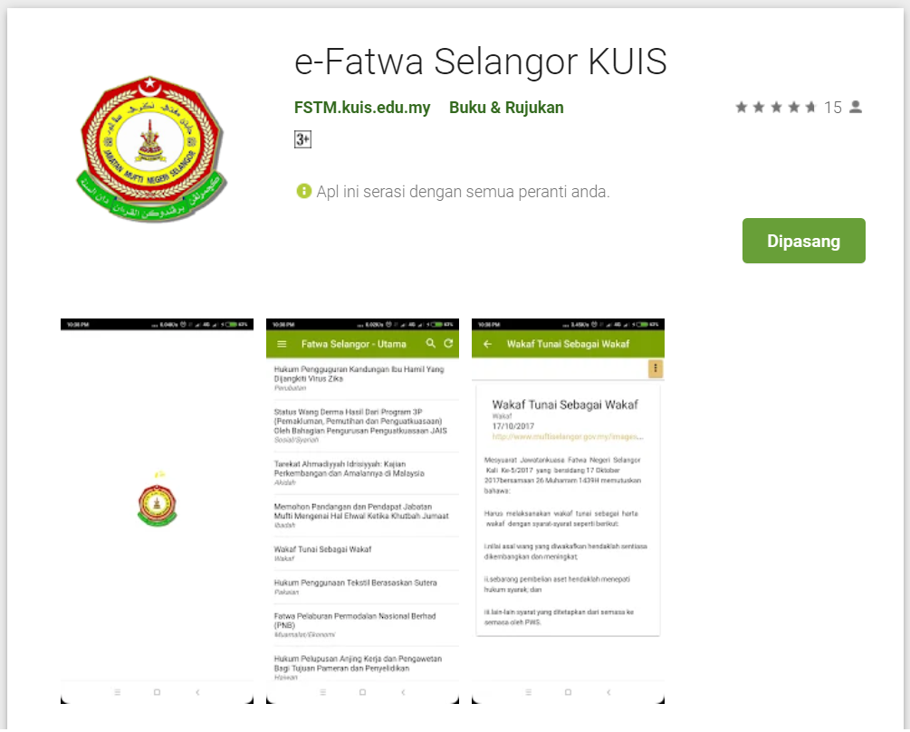
Available apps

Slide 8
IOS & Android Software Development
In a nutshell

Slide 9
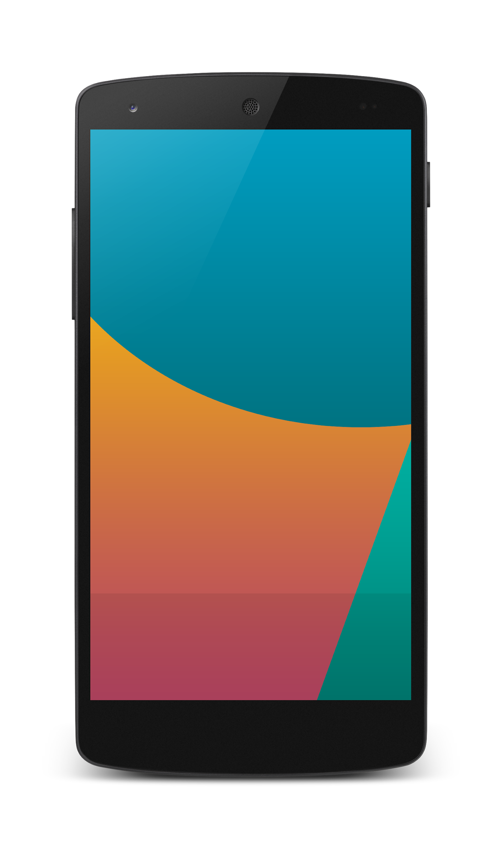


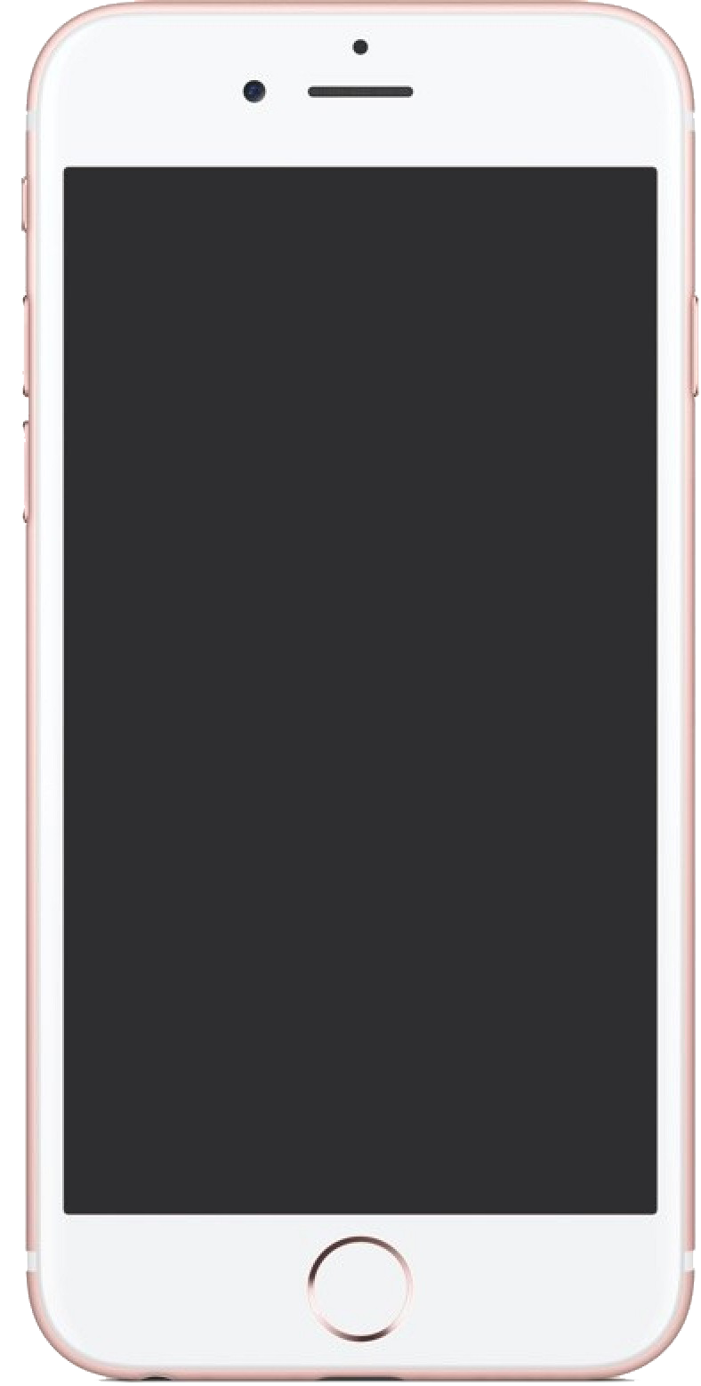

Android Studio
(Java & Kotlin)
Android Device
NATIVE - 2 X WORK
XCode (Swift & Objective C)
iPhone/iPad

Slide 10

1 x WORK
Compile with Android SDK
Android Device
Cordova
Framework
Hybrid
XCode Project
iPhone/iPad

Slide 11
Cordova
Framework
Hybrid
WEB LAYER
NATIVE APP

Slide 12
1 x WORK
Build Progressive Web Apps
Android Device
Build Progressive Web Apps
Cordova
Framework
Hybrid
iPhone/iPad

Slide 13


1 x WORK
Android Studio
Android Device
+
XCode
iPhone/iPad

Slide 14
https://capacitor.ionicframework.com/

Slide 15



WHY IONIC?
Framework specifically to develop apps
Multiple platforms-Android, IOS, Windows, Amazon etc
Apps development using HTML & Typescript (subset of Javascript)
Plugins (camera, thumbprint, bluetooth, printer etc etc etc)

Slide 16
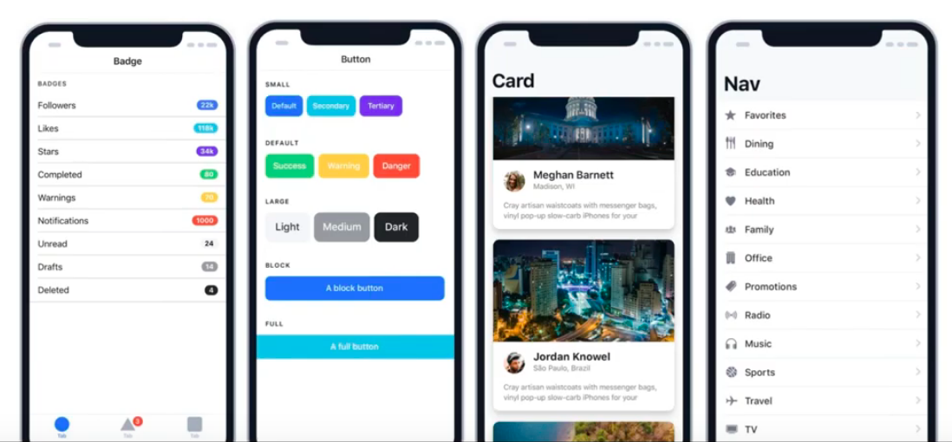
WHY IONIC?
Large COMMUNITY for support
Pre built gestures & animation
100+ UI Components
Everything is OPEN SOURCE
Built with Ionic

Slide 17
Software to start Ionic?

Slide 18
What do you need?
To run IONIC:
Node Package Manager (NPM)
Ionic Cordova Framework
Google Chrome Web Browser
To develop/publish app
VSCode OR any other IDE (with Typescript Plugin)
Ionic Capacitor
Android SDK or Xcode - can be done later

Slide 19
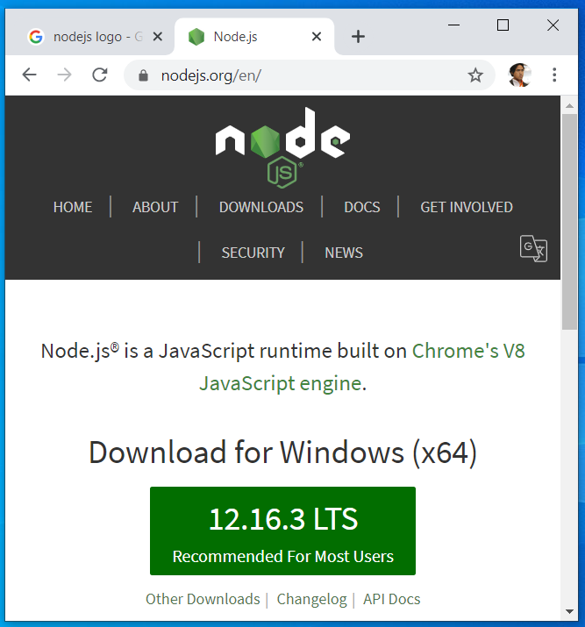

Download from nodejs.org
Download and install the LTS version
http://nodejs.org

Slide 20
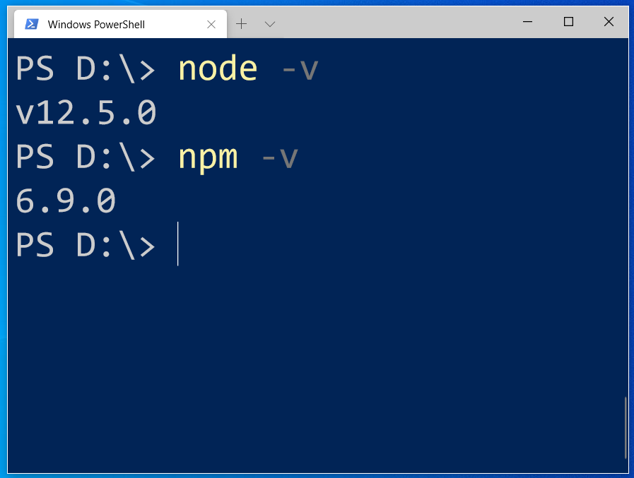
After install NodeJS from nodejs.org
node -v
npm -v

Slide 21
2. From command terminal run:
npm install -g ionic cordova

Slide 22
Now, let’s install the tools

Slide 23
Install VSCode/sublime
NodeJS
Tutorial is here bit.ly/ionickerul
Install Google Chrome Browser
(If you don’t have, you should)

Slide 24
Before we start coding, some basic stuff...

Slide 25
-HTML?
-CSS ?
-TypeScript ?

Slide 26
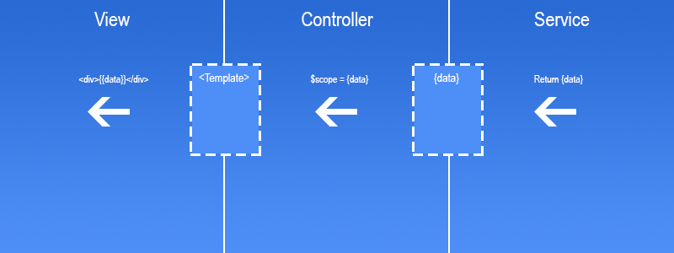
Simple MVC in Ionic
.HTML | .TS | services .TS /Model

Slide 27
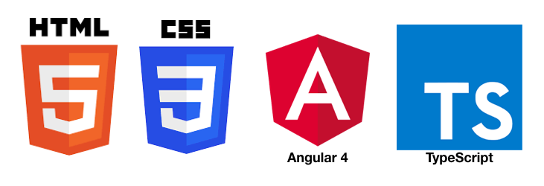
HTML
-Hyper Text Mark Up Language (HTML)
-Used to display the interface
-Write in tags,
-Example- <strong>Hello</strong> → Hello
-Ionic has its own built in tags
<ion-list></ion-list>
<ion-item></ion-item>
<ion-grid></ion-grid>
-HTML in Ionic is “AngularJS Flavoured”
-Have to use Angular Syntax for data and clicks
-Example- (click), *ngFor etc

Slide 28
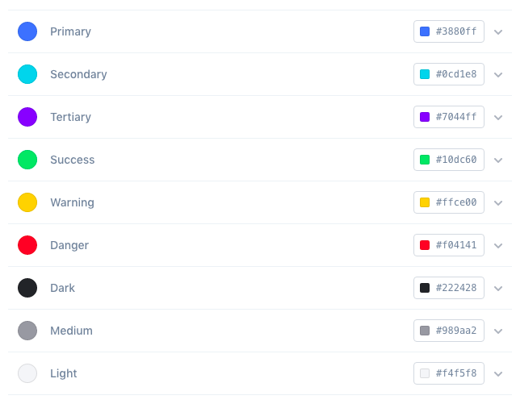
CSS or SCSS
-Cascading Style Sheets (CSS)
-Used for styling, very straightforward
-Each generated Ionic page comes with built in own CSS
-Can assist in ‘theming’ the app
-Ionic has standard built in colours
-Primary, Secondary, Danger, Light & Dark
Built in colours that can be added/edited

Slide 29
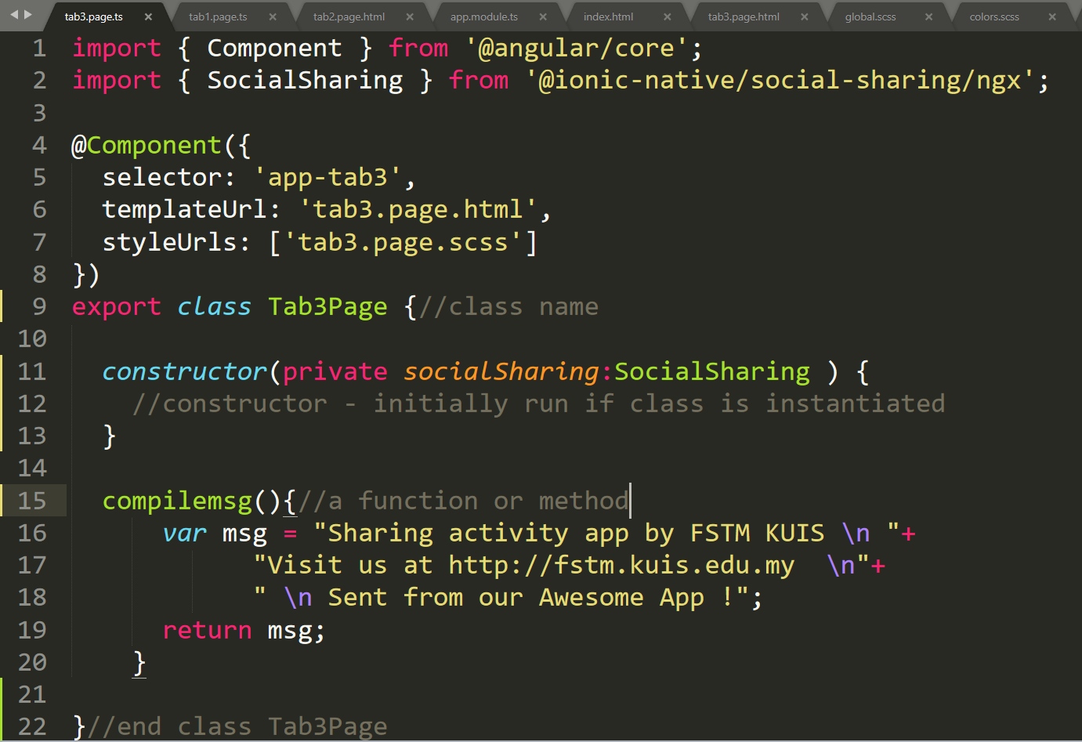
Class Function

Slide 30
Hello World ionic

Slide 31
1. Start a project
ionic start appfstm tabs

Slide 32
2. CD into Directory & Run the project
ionic serve

Slide 33
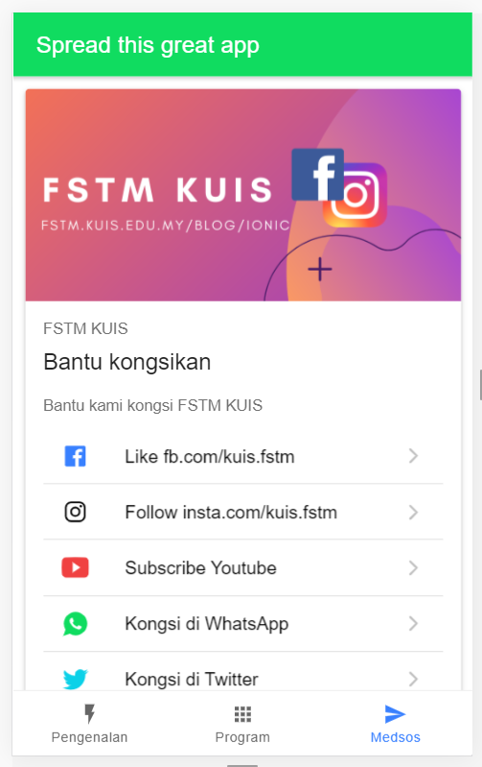
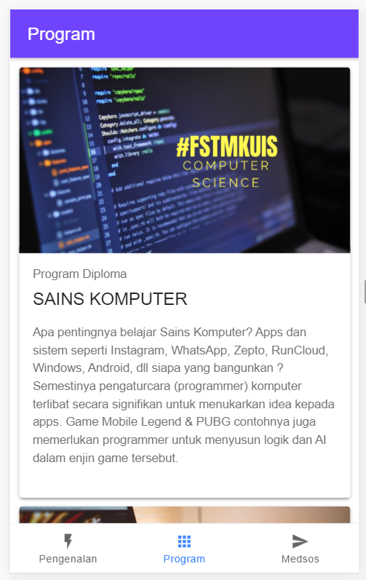
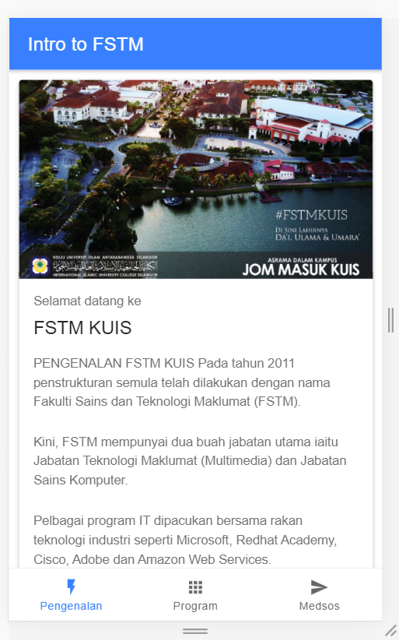
Next tab2 and tab3

Slide 34


bit.ly/ionkerul
T02 HTML interface
(antaramuka)

Slide 35
1. Start a project
ionic start appfstm tabs

Slide 36
2. CD into Directory & Run the project
ionic serve

Slide 37
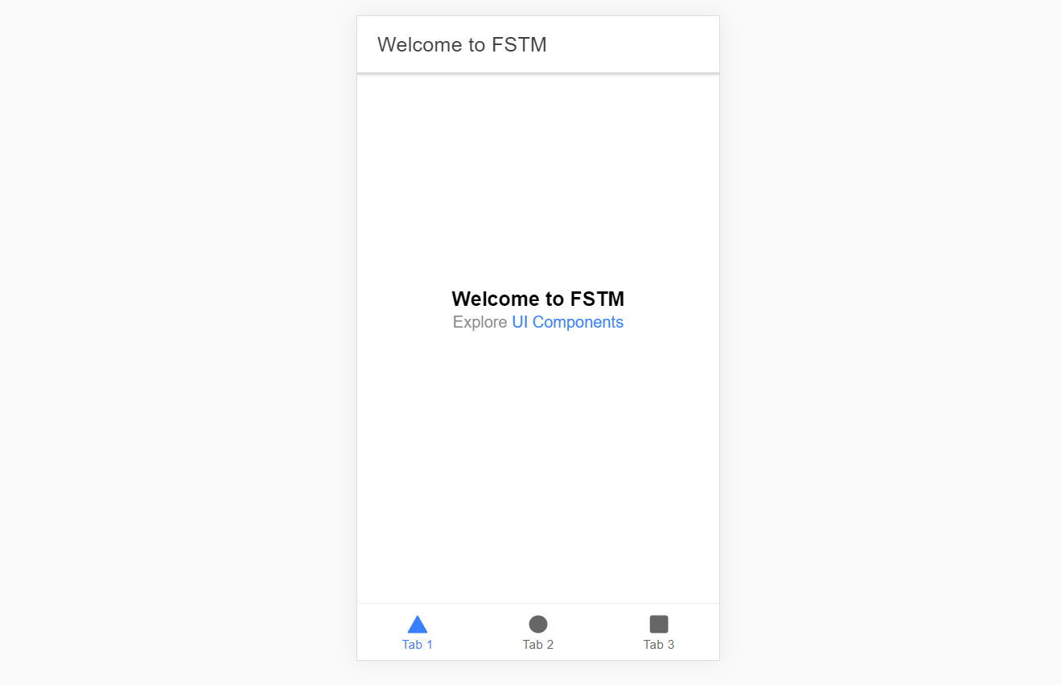
Output : ionic serve

Slide 38
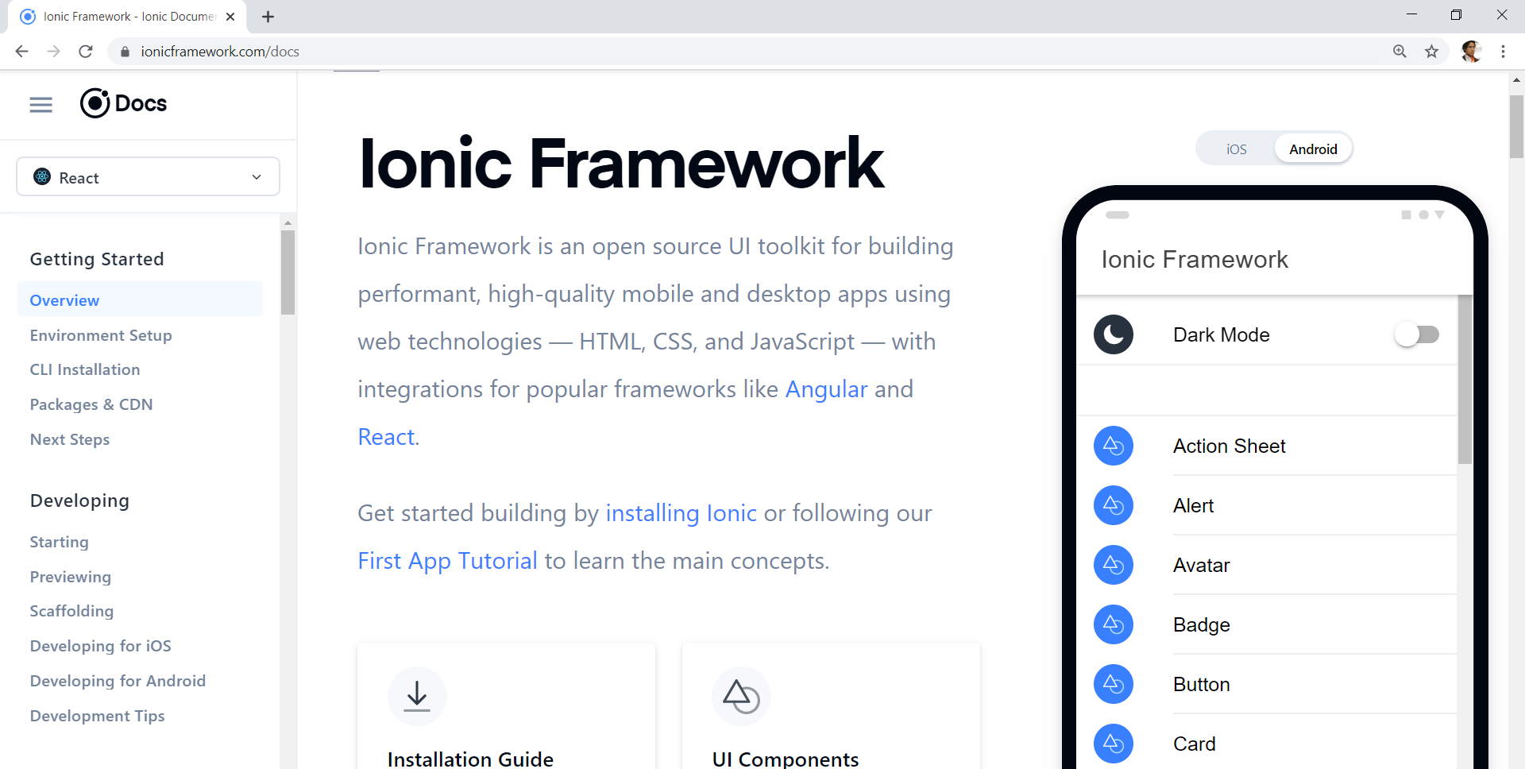
Always refer to documentations: https://ionicframework.com/docs

Slide 39
HTML
-Hyper Text Mark Up Language (HTML)
-Used to display the interface
-Write in tags,
-Example- <strong>Hello</strong> → Hello
-Ionic has its own built in tags
<ion-list></ion-list>
<ion-item></ion-item>
<ion-grid></ion-grid>
-HTML in Ionic is “AngularJS Flavoured”
-Have to use Angular Syntax for data and clicks
-Example- (click), *ngFor etc

Slide 40
CSS or SCSS
-Cascading Style Sheets (CSS)
-Used for styling, very straightforward
-Each generated Ionic page comes with built in own CSS
-Can assist in ‘theming’ the app
-Ionic has standard built in colours
-Primary, Secondary, Danger, Light & Dark
Built in colours that can be added/edited

Slide 41
Next tab2 and tab3

Slide 42
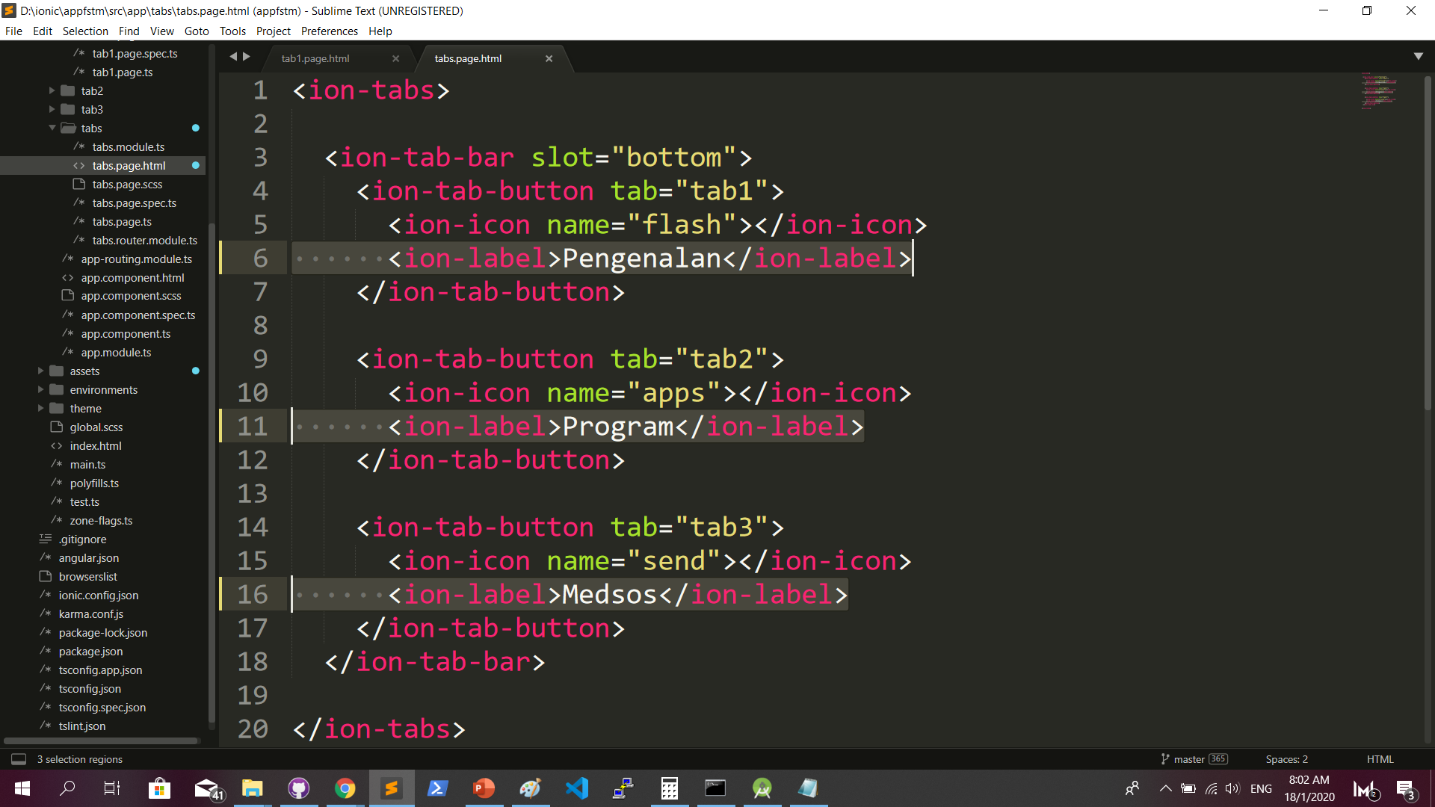
Some interface cosmetics: src/app/tabs/tabs.page.html

Slide 43
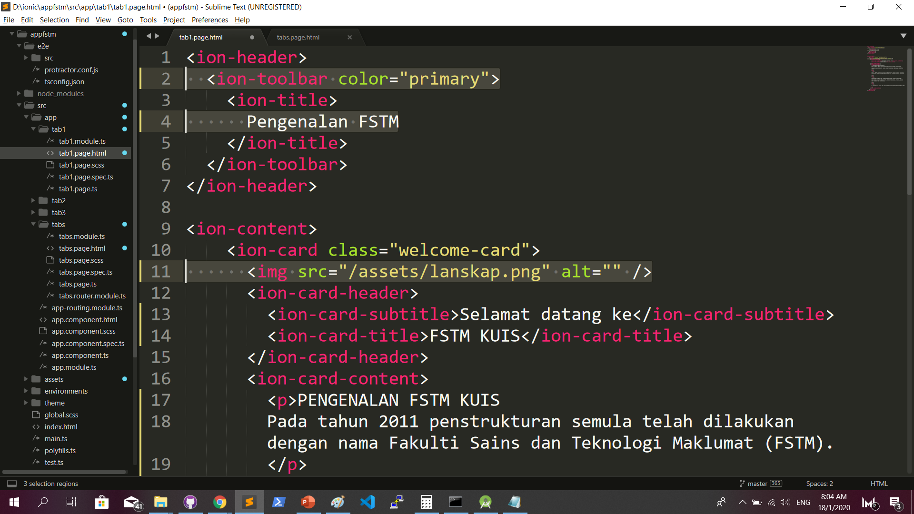
More interface cosmetics: src/app/tab1/tab1.page.html

Slide 44
Run ionic serve

Slide 45
Next tab2 and tab3

Slide 46
Codes & slides github.com/khirulnizam/ionic5

Slide 47
bit.ly/ionkerul
T03 Navigasi
(page navigation)

Slide 48
Page Navigation
+ routerLink (in .html) + NavController (in .ts)

Slide 49
routerLink in HTML
PAGE 1
PAGE 2
See app-routing.module.ts for page name

Slide 50
Exercise : Link to new page
Generate new pages
ionic g page info
ionic g page form

Slide 51
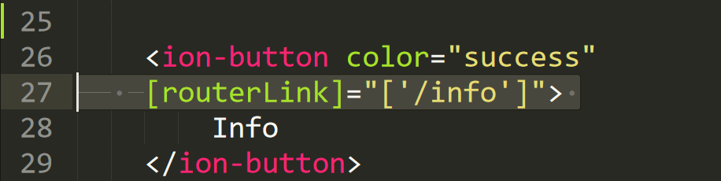
Exercise : Link to new page

Slide 52
NavController in TS
PAGE 1
PAGE 2
See app-routing.module.ts for page name

Slide 53
Add simple form interaction
+ Form Button + Alert function

Slide 54
Try building a button and make an alert
helloWorld(){
alert(“Hello Ionic!”)
}
<ion-button (click)=”helloWorld()”> ALERT </ion-button>
info.page.ts
info.page.html

Slide 55
Codes & slides github.com/khirulnizam/ionic5

Slide 56

bit.ly/ionkerul
Ionic
T04 TypeScript

Slide 57
TypeScript
-A subset of Javascript
-Part of ECMA6 standard
-The ‘brains’ behind your app
-Used for processing & handling data
Example- calculation, accessing DB etc
-Ionic has standard built in to its TS:
NavController, ModalController etc

Slide 58

Dart Syntax simplified…
What is a variable?
double pi = 3.14;
String name=‘enKerul’;
A variable, by definition, is “a named space in the memory” that stores values
In other words, it acts as a container for values in a program
Data types:
Var
can be numbers or words
String
“this is string ” + “ concat”
Objects
{name: “Mickey”}
Array
can be a collection of Var, Strings or Objects

Slide 59
Dart Syntax simplified…
String manipulation?
String stringpi = “3.14”;
double pi = 3.14;
print('pi is $pi');
print('tau is ${2 * pi}');
To convert String to number var
numpi = int.parse(stringpi);
num=double.parse(stringpi);

Slide 60
Dart Syntax simplified…
Array? Array
can be a collection of Var, Strings or Objects
// A list literal.
var lostNumbers = [4, 8, 15, 16, 23, 42];
print(lostNumbers.last);
Output: 42
// A map literal.
// Asociative array
var nobleGases = {
'He': 'Helium',
'Ne': 'Neon',
'Ar': 'Argon',
};
print(nobleGases['Ne’]);
Output: Neon

Slide 61
bit.ly/ionkerul
Ionic
T05 Page Navigation (with parameters)

Slide 62
Parameters
2 methods

Slide 63
Using Services,
SEE DAY 2 LESSON
2. Using ActivatedRoute
*CAN SEND OBJECTS
*CANNOT SEND OBJECTS

Slide 64
PARAMETERS
PAGE 1
PAGE 2
Name: Kerul
Name: Kerul
Name: Kerul

Slide 65
Using ActivatedRoute
On app-routing.module.ts add param name, example /:id
Add /id when navigating
To get param
import {ActivatedRoute} from ‘@angular/router’
public route:ActivatedRoute
let the_id=this.route.snapshot.params.id

Slide 66
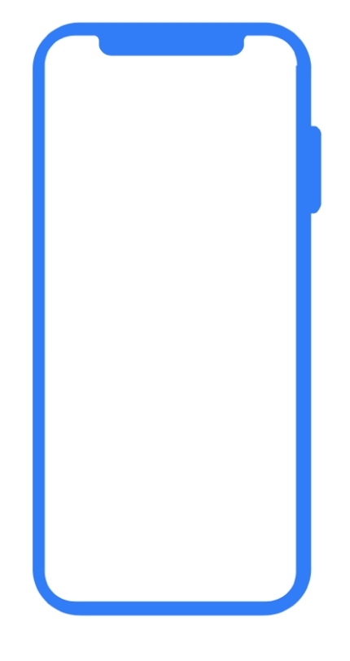

Ionic5 vs Flutter
bit.ly/ionkerul

